Slide 1
Mini Group Project Ⅱ Free International Trade IPEN 5810
Presented by Xinyu WU &Chengyue LAI

Slide 2
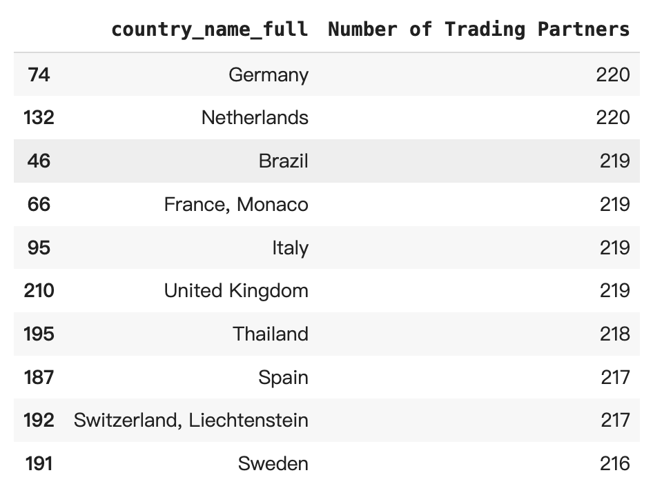
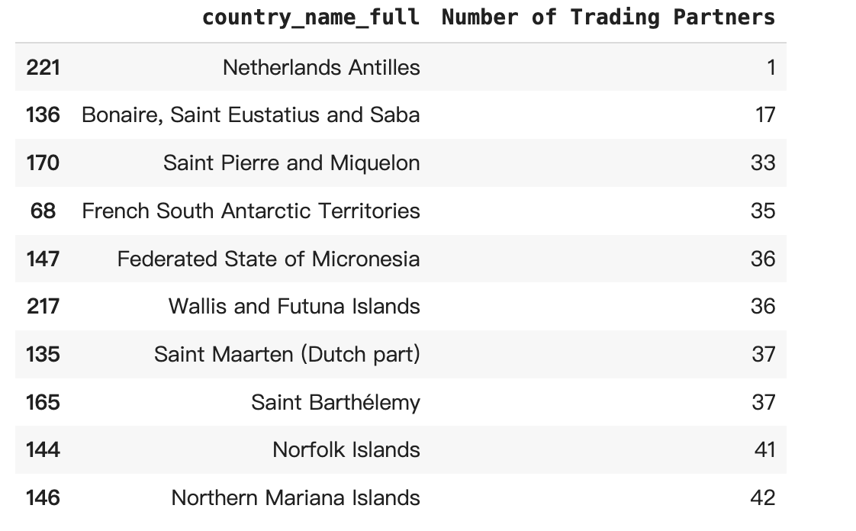

1. Descriptive analysis
1.1 Trading partners
Top 10 Countries:
Most trade partners：
Bottom 10 Countries:
Fewest trade partners：
Economically developed countries
Trade hub
Remote geographical location
Small or less populous island countries
Notes:
Summary of the change before and after the TCJA
C corporations: big firms tiny fraction pay a lot of taxes
S corporations: small business not employ many people
The third row is significant, first time of change of deduction regime

Slide 3
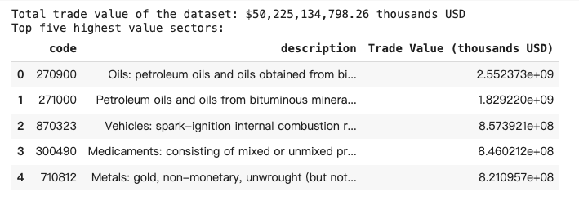
1. Descriptive analysis
1.2 Trading Sectors
Top 5 Sectors:
in terms of Value：Reflecting their importance and level of demand in the global economy
energy production
widespread consumption and industrial applications
Notes:
Summary of the change before and after the TCJA
C corporations: big firms tiny fraction pay a lot of taxes
S corporations: small business not employ many people
The third row is significant, first time of change of deduction regime

Slide 4
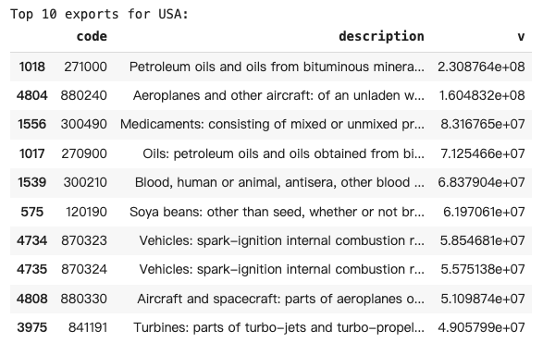
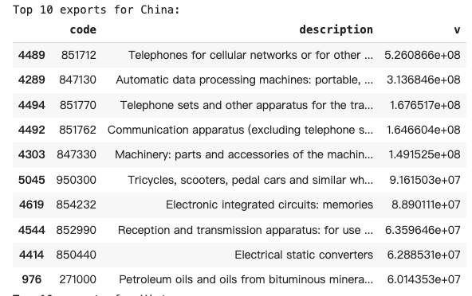
1. Descriptive analysis
1.3 USA, EU, China, and Vietnam
Top 10 Exports:
strong export capabilities in the energy, high-tech, pharmaceutical, and agricultural sectors - USA
leading position in global electronic manufacturing and technological equipment - China
Notes:
Summary of the change before and after the TCJA
C corporations: big firms tiny fraction pay a lot of taxes
S corporations: small business not employ many people
The third row is significant, first time of change of deduction regime

Slide 5
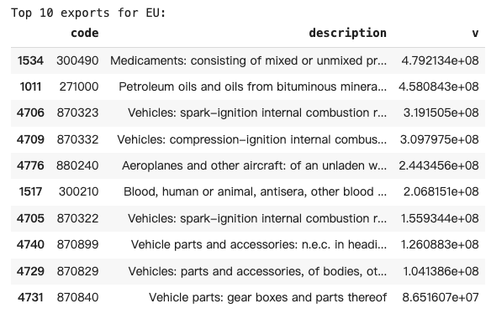
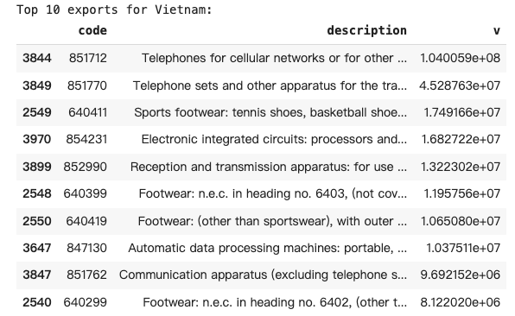
1. Descriptive analysis
1.3 USA, EU, China, and Vietnam
Top 10 Exports:
Concentrated in electronic communication equipment；
Strongcapabilities in manufacturing light industrial products and electronic equipment - Vietnam
leading position in high-tech manufacturing and heavy industry - EU
Notes:
Summary of the change before and after the TCJA
C corporations: big firms tiny fraction pay a lot of taxes
S corporations: small business not employ many people
The third row is significant, first time of change of deduction regime

Slide 6
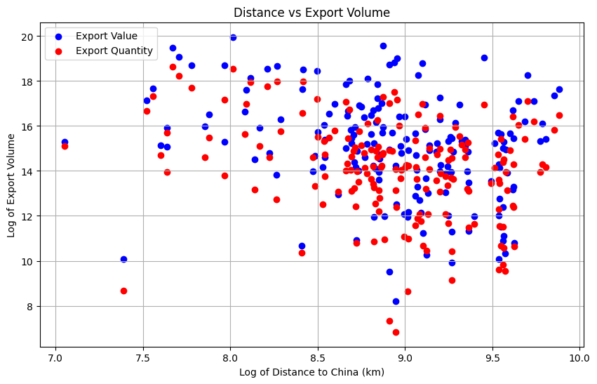
1. Descriptive analysis
1.4 Distance and Export values
China as an exporting country:
For China, distance will reduce its export values
Notes:
Summary of the change before and after the TCJA
C corporations: big firms tiny fraction pay a lot of taxes
S corporations: small business not employ many people
The third row is significant, first time of change of deduction regime

Slide 7
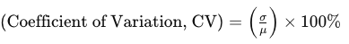
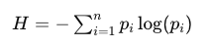
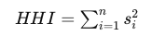
2. Identifying Trade Patterns - K-means
2.1 Identifying trade patterns
All features → Further selecting through PCA
Export/Import Values
1. Values: export_value & import value & total trade value;
2. Balance ratio = Export value/ Import value;
3. Stability index = Weighted average of export volatility and import volatility - export & import & total
4. Top5 industry trade values;
5. Industry diversity - Information Entropy;
6. Industry concentration - HHI Index - Most trade is controlled by a few industries
Sectors
Distance
7. Number of trading partners;
8. Average trade distance - export_distance&import_distance
9. Farthest trade distance
Notes:
Summary of the change before and after the TCJA
C corporations: big firms tiny fraction pay a lot of taxes
S corporations: small business not employ many people
The third row is significant, first time of change of deduction regime

Slide 8
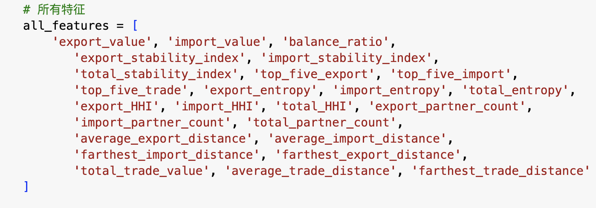
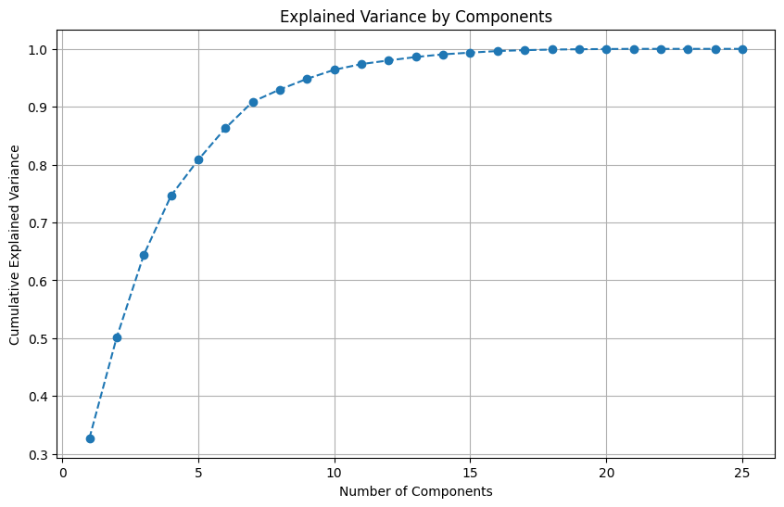
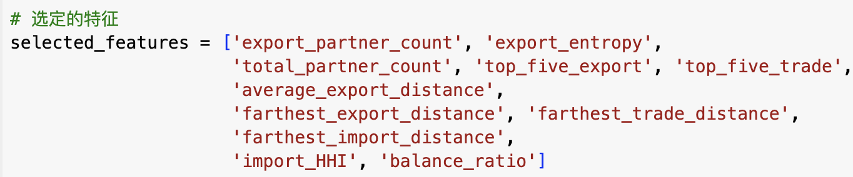
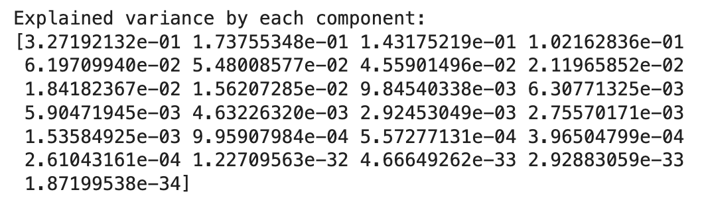
2. Identifying Trade Patterns - K-means
2.1 Identifying trade patterns
All features → Further selecting through PCA
1. Standardization
2. Use PCA to retain important principal components (cumulative explanatory variance>0.8)
3. Obtain the feature payload of principal components - filter out the original features
4. Use the filtered original features for k-means clustering
Notes:
Summary of the change before and after the TCJA
C corporations: big firms tiny fraction pay a lot of taxes
S corporations: small business not employ many people
The third row is significant, first time of change of deduction regime

Slide 9
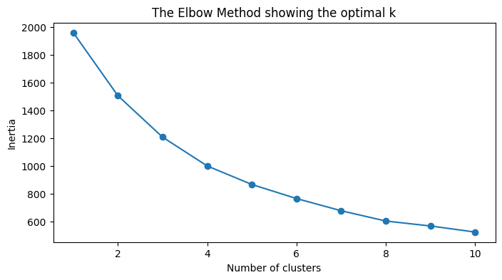
2. Identifying Trade Patterns - K-means
2.2 Number of clusters - 4
Notes:
Summary of the change before and after the TCJA
C corporations: big firms tiny fraction pay a lot of taxes
S corporations: small business not employ many people
The third row is significant, first time of change of deduction regime

Slide 10
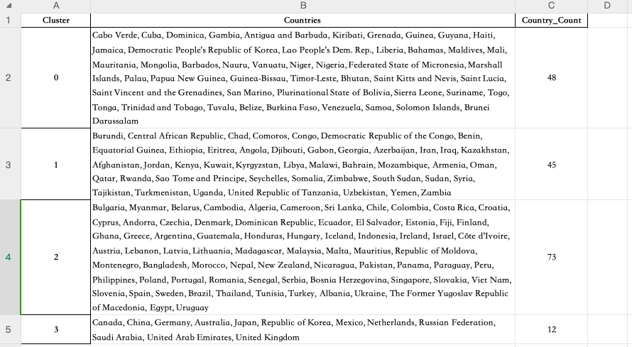
2. Identifying Trade Patterns - K-means
2.3 Cluster Results - Country Distribution
Notes:
Summary of the change before and after the TCJA
C corporations: big firms tiny fraction pay a lot of taxes
S corporations: small business not employ many people
The third row is significant, first time of change of deduction regime

Slide 11
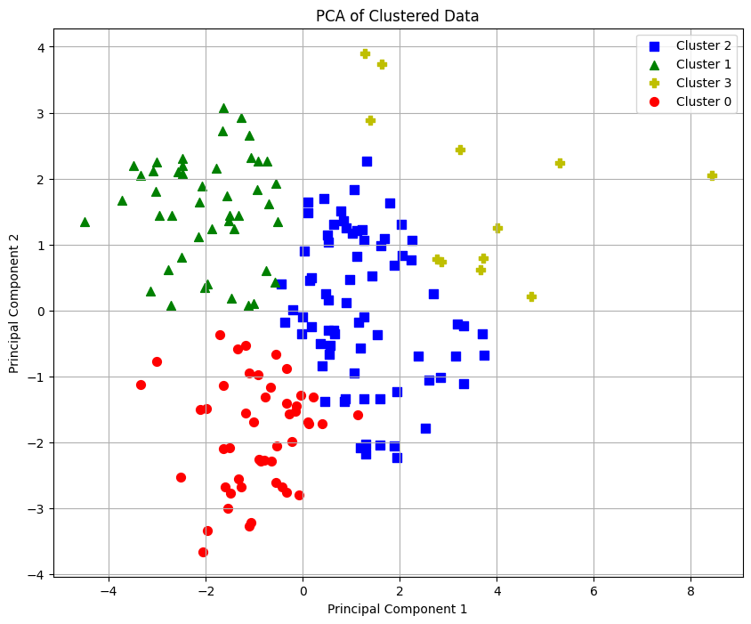
2. Identifying Trade Patterns - K-means
2.4 Visualization - PCA
Notes:
Summary of the change before and after the TCJA
C corporations: big firms tiny fraction pay a lot of taxes
S corporations: small business not employ many people
The third row is significant, first time of change of deduction regime

Slide 12
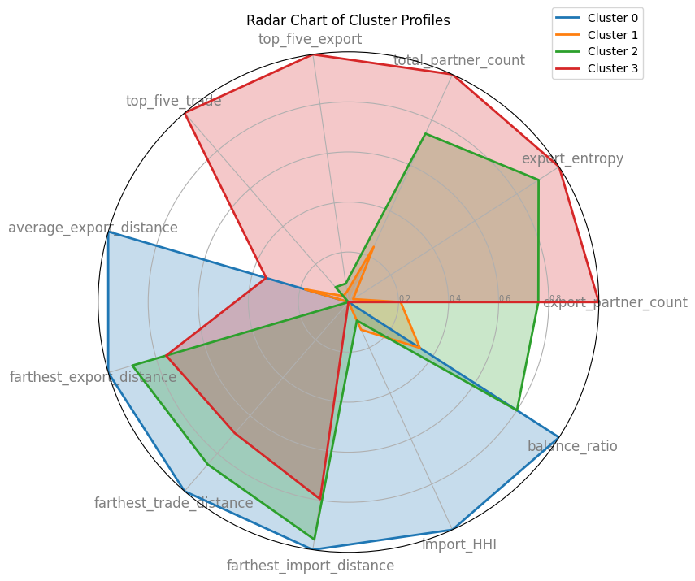
2. Identifying Trade Patterns - K-means
2.4 Visualization - Radar Chart
Cluster0: High trade distance & Few partners & Low diversity
Remote market dependent countries (e.g., Australia, Chile)
Cluster1: Low distance & Low trade value & Low diversity
Geo trade dependent small countries (e.g., Andorra, Monaco)
Cluster2: High trade distance & Low trade value & High diversity
Diversified but low trade volume far away countries (e.g.,Bahamas, Fiji)
Cluster3：High trade value & High diverse & High balance
A strong country with diversified economy (e.g.,China, Germany)
Notes:
Summary of the change before and after the TCJA
C corporations: big firms tiny fraction pay a lot of taxes
S corporations: small business not employ many people
The third row is significant, first time of change of deduction regime

Slide 13
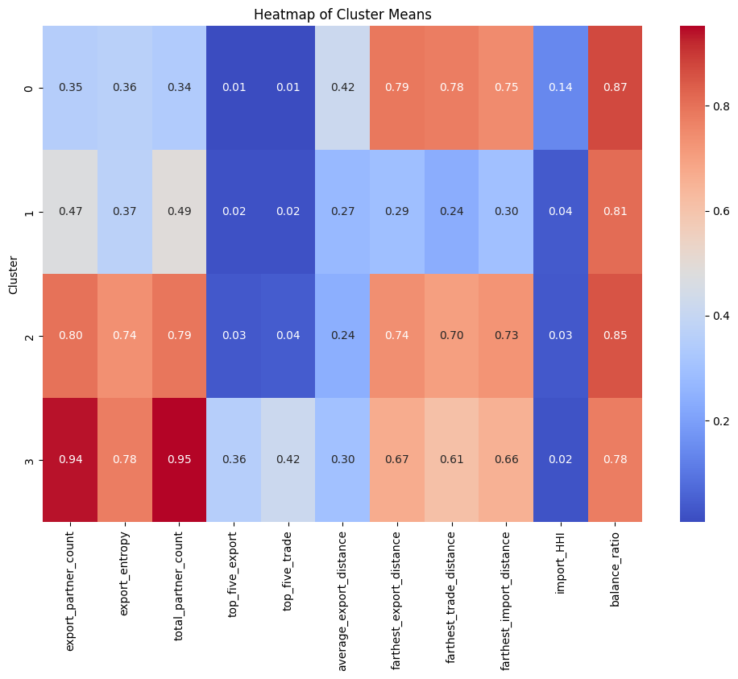
2. Identifying Trade Patterns - K-means
2.4 Heat Map
- Mean distribution
Some findings & economic implications:
1. average_export_distance & export_entropy
Can the farther the export distance represent diversified exports?
seems negative correlation in cluster0,1,2 (not Great Trade Country）;
but due to the inability of non trading powers to compete in the global commodity market, they may focus on diversifying their product exports to meet the unique needs of long-distance markets - maybe positive correlation.
Worth further exploration both correlation and causality
Notes:
Summary of the change before and after the TCJA
C corporations: big firms tiny fraction pay a lot of taxes
S corporations: small business not employ many people
The third row is significant, first time of change of deduction regime

Slide 14
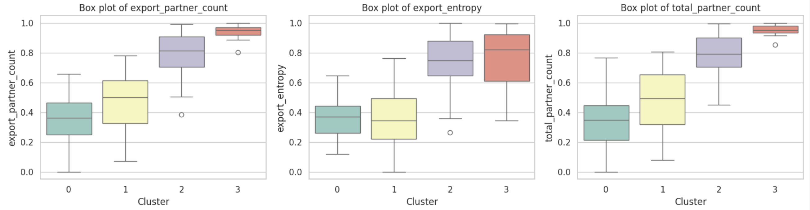
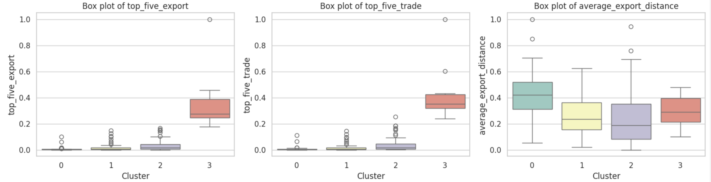
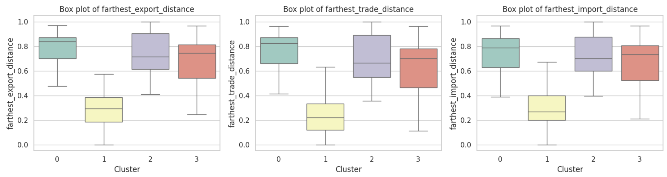
2. Identifying Trade Patterns - K-means
2.4 Box Chart
—— Median & Quartiles & Outliers & Whiskers
Findings：
1. Cluster 3 has a small number of outliers in various features; And the distribution of values is relatively concentrated
Reasons: Cluster 3 belongs to countries with abundant resources and mature trade - high trade stability
Notes:
Summary of the change before and after the TCJA
C corporations: big firms tiny fraction pay a lot of taxes
S corporations: small business not employ many people
The third row is significant, first time of change of deduction regime

Slide 15
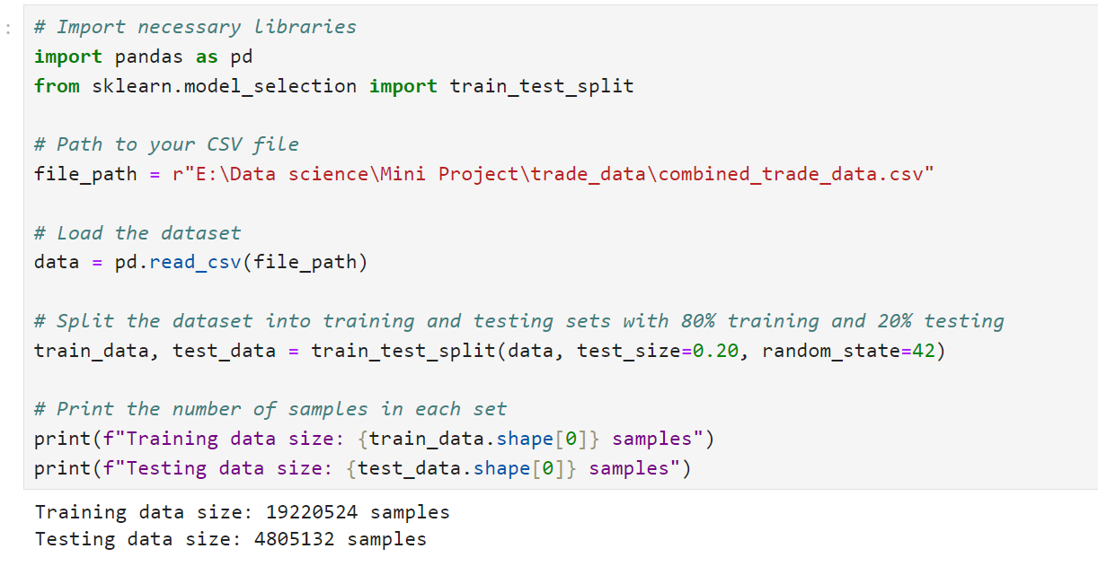
3. Machine Learning: Predicting Trade Flows
Training Set:
The training set is a subset of data used for training machine learning models.
It comprises the majority of the data, usually around 70% - 80% of the dataset.
Models learn features and patterns on the training set to make accurate predictions.
Test Set:
The test set is a subset of data used to evaluate the performance of models.
It contains data samples not used during the training process.
Models make predictions on the test set and compare them with actual labels to assess their generalization ability and performance.
Validation Set:
In some cases, the dataset may also be split into a validation set for model selection and tuning.
The validation set is used to adjust model hyperparameters, such as learning rate and regularization parameters.
Typically, the validation set is smaller, around 10% - 20% of the dataset.
Notes:
Summary of the change before and after the TCJA
C corporations: big firms tiny fraction pay a lot of taxes
S corporations: small business not employ many people
The third row is significant, first time of change of deduction regime

Slide 16
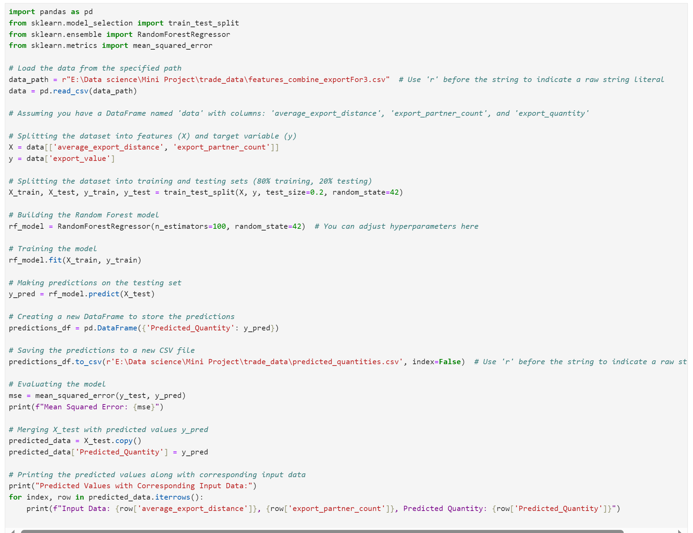
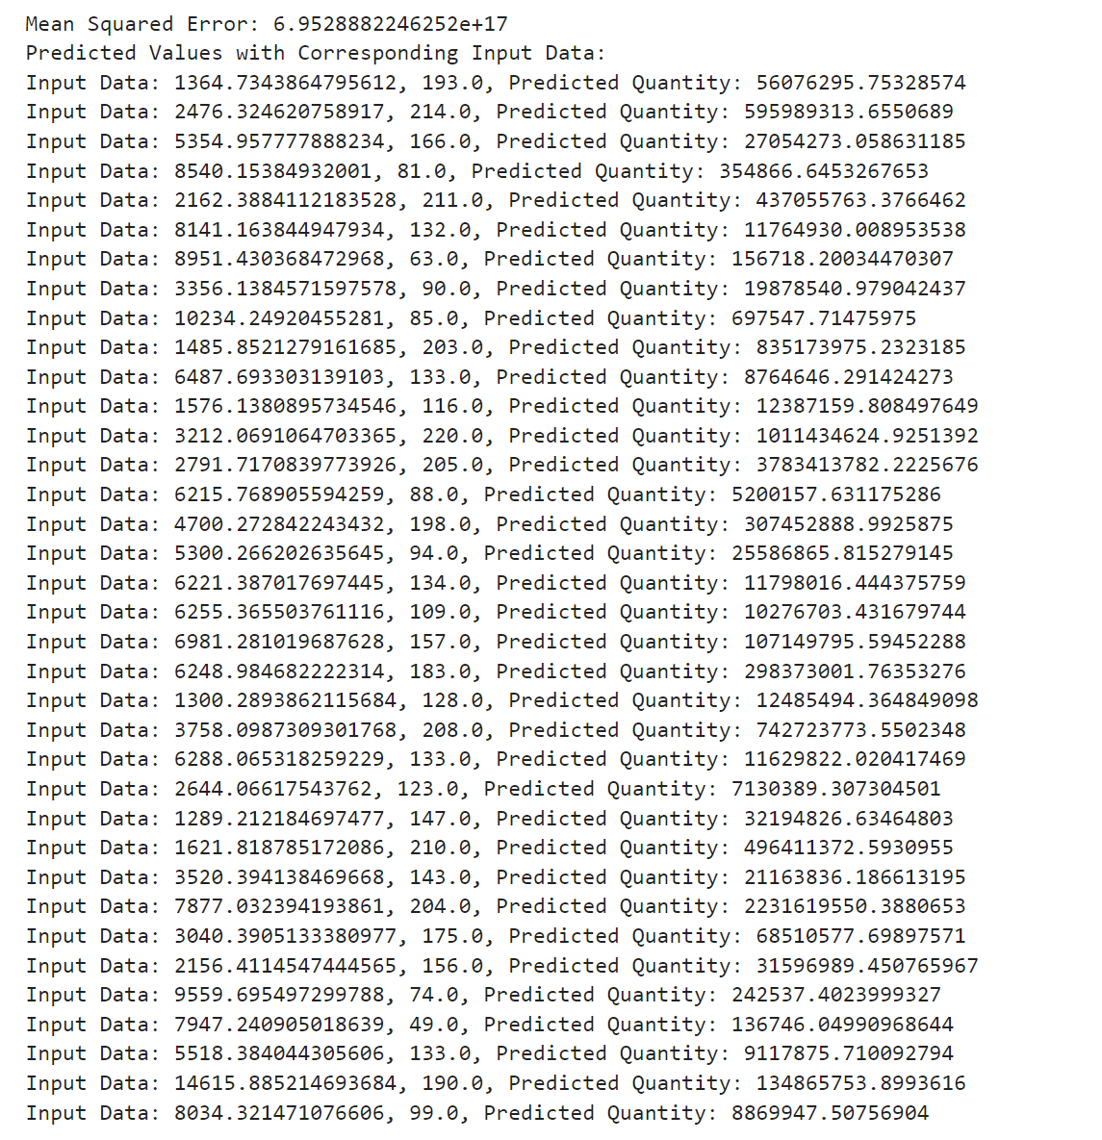
3. Machine Learning: Predicting Trade Flows
Notes:
Summary of the change before and after the TCJA
C corporations: big firms tiny fraction pay a lot of taxes
S corporations: small business not employ many people
The third row is significant, first time of change of deduction regime

Slide 17
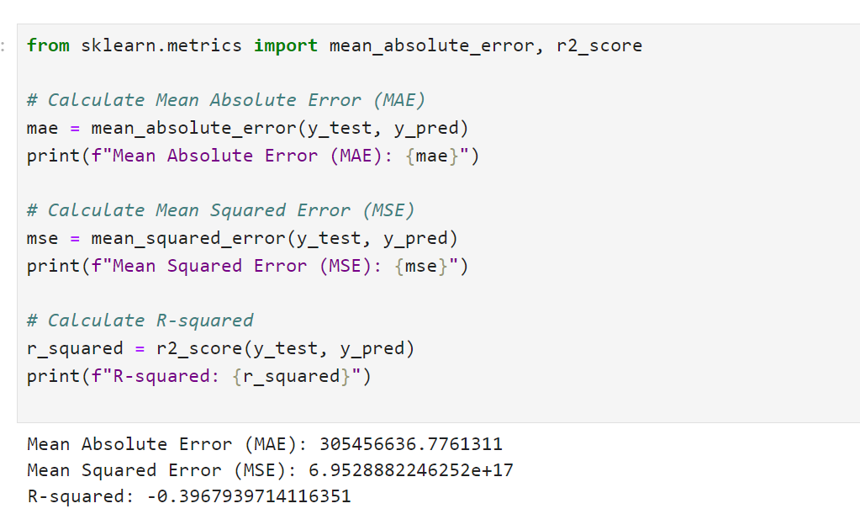
3. Machine Learning: Predicting Trade Flows
Mean Absolute Error (MAE):
MAE measures the average absolute difference between the predicted values and the actual values.
It is calculated by taking the average of the absolute differences between predicted and actual values.
MAE is easy to interpret, as it represents the average magnitude of errors in the predictions.
However, MAE does not penalize large errors more heavily than smaller errors.
Mean Squared Error (MSE):
MSE measures the average squared difference between the predicted values and the actual values.
It is calculated by taking the average of the squared differences between predicted and actual values.
MSE penalizes larger errors more heavily than smaller errors, as it squares the differences.
However, MSE is sensitive to outliers, as large errors contribute disproportionately to the overall score.
R-squared (R²):
R-squared measures the proportion of the variance in the dependent variable that is explained by the independent variables in the model.
It is calculated by dividing the explained variance by the total variance.
R-squared ranges from 0 to 1, where 0 indicates that the model does not explain any variance and 1 indicates a perfect fit.
R-squared provides a measure of how well the model fits the data relative to a simple average.
However, R-squared may not be suitable for comparing models with different numbers of predictors.
Notes:
Summary of the change before and after the TCJA
C corporations: big firms tiny fraction pay a lot of taxes
S corporations: small business not employ many people
The third row is significant, first time of change of deduction regime

Slide 18
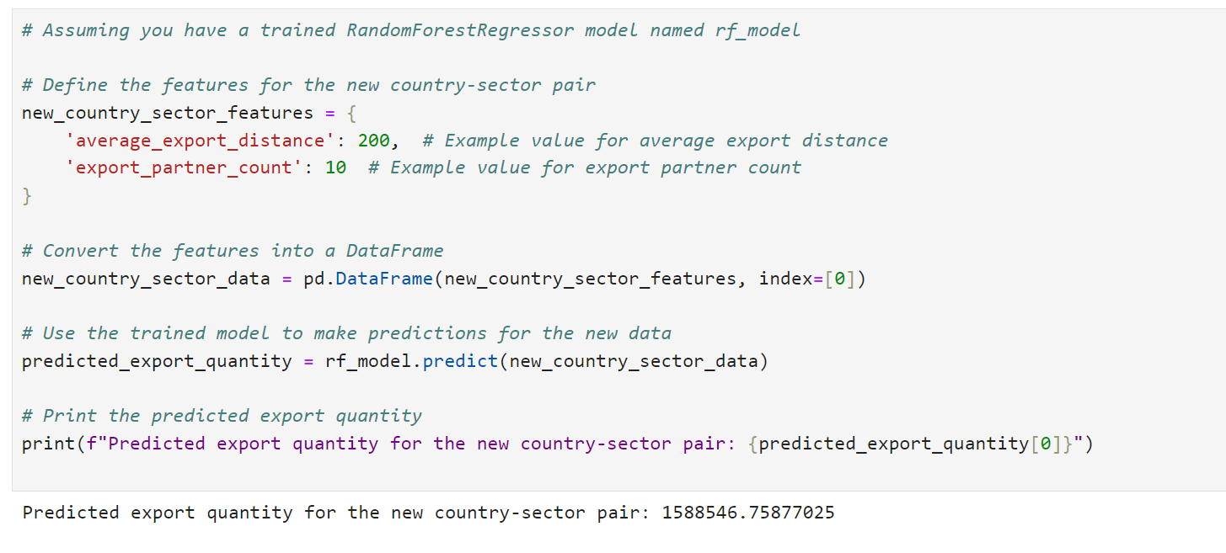
3. Machine Learning: Predicting Trade Flows
Notes:
Summary of the change before and after the TCJA
C corporations: big firms tiny fraction pay a lot of taxes
S corporations: small business not employ many people
The third row is significant, first time of change of deduction regime

Slide 19



4. Which commodity sectors is distance most important in terms of exporting
Regression model - Trade record level
$${Export Value}_{ijk}=α+{β_{1}Distance}_{ij}+\sum_{k=1}^{K}{δ_{k}}({Distance}_{ij}×{Sector}_{k})+ε_{ijk}$$
$${Export Value}_{ijk}：$$
The export value of country i to country j in the commodity sector k
$${Distance}_{ij：}$$
The distance between country i and country j
$${Sector}_{k}：$$
Dummy variable in the commodity department
$${Distance}_{ij}×{Sector}_{k}：$$
Key interaction term: the moderating effect of distance on the export value of different commodity sectors
Data
Export data: The export value of each country to each commodity sector。
Distance data: The geographical distance between exporting and importing countries
Control variables: including economic indicators such as GDP and population, as well as possible other trade barriers (such as tariffs, language, cultural differences, etc.)
Notes:
Summary of the change before and after the TCJA
C corporations: big firms tiny fraction pay a lot of taxes
S corporations: small business not employ many people
The third row is significant, first time of change of deduction regime

Slide 20



Thank You!
Thank you!

